Slide 1
What is Denial of Service Attack?
Main aim to stop the victim’s machine from doing it’s required job
Server unable to provide service to legitimate clients
Damage done varies from minor inconvenience to major financial losses

Slide 2
Types of Attacks
Bandwidth Consumption: All available bandwidth used by the attacker e.g.,ICMP ECHO attack
Resource Consumption: Resources like web server, print or mail server flooded with useless requests e.g., mail bomb
Network Connectivity: The attacker forces the server to stop communicating on the network e.g., SYN Flooding.

Slide 3
SYN Flooding Attack
Network connectivity attack
Most commonly-used DoS attack
Launched with a little effort
Presently, difficult to trace attack back to its originator
Web servers and systems connected to Internet providing TCP-based services like FTP servers, mail servers are susceptible
Exploits TCP’s three-way handshake mechanism and its limitations in maintaining half open connections

Slide 4


TCP Protocol: Three-way Handshake
Client connecting to TCP port
SYN
LISTEN
Client requests for connection
ACK + SYN
SYN_RCVD
Server agrees for connection request
ACK
CONNECTED
Client finishes handshake
S
D

Slide 5
Three-way Handshake
Initialize sequence numbers for a new connection (x,y)
SYN x
LISTEN
Resources allocated
SYN y +ACK x+1
SYN_RCVD
ACK y+1
CONNECTED
S
D

Slide 6



How SYN Flooding Attack Works?
Client connecting to TCP port
Uses spoofed addresses
SYN
Resources allocated for every half open connection
SYN + ACK
SYN
SYN + ACK
I have ACKed these connections but I have not received an ACK back!
SYN
Limit on number of half open connections
SYN + ACK
Attacker
Victim

Slide 7
Attack Modes
Different parameters by which SYN flood attack can vary:
Batch-size : Number of packets sent from source address in a batch
Delay : Time interval between two batches of packets sent
Source address allocation
  Single Address: Single forged address
  Short List: Small list to pick source addresses
  No List: Randomly created source addresses

Slide 8
Solutions
Using firewall
System configuration improvements
SYN cache

Slide 9
Using Firewalls
Two ways in which firewall used:
  Firewall as a relay: Packets from source received and answered by the firewall
  Firewall as a semi-transparent gateway: Lets SYN and ACK to pass, monitors the traffic and reacts accordingly

Slide 10
Firewall as a Relay
Attack with Relay Firewall
Acts as a proxy
SYN
SYN+ACK
SYN
SYN+ACK
A
FIREWALL
D

Slide 11
Firewall as a Relay (cont’d)
Legitimate connection with relay firewall
SYN
SYN+ACK
SYN
ACK
SYN+ACK
Data
ACK
Data
Data
Data
Sequence number conversion
S
Firewall
D

Slide 12
Spoofing via raw socket interface cont’d….
Unfortunately removal of raw sockets API is not an apt solution to prevent DoS attacks
  Microsoft’s removal of raw sockets API in the release of Windows XP Service Pack 2 in August 2004 was expected to break applications like the public domain nmap port scanner
  In just a few days, a workaround was produced restoring the ability of nmap to craft custom packets
    http://seclists.org/nmap-hackers/2004/0008.html
Source: Mirkovic, J., Dietrich, S., Dittrich, D., & Reiher, P. (2005)

Slide 13
SYN spoofing
Takes advantage of the three-way handshake that occurs any time two systems across the network initiate a TCP connection request
Unlike usual brute-force attack, not done by exhausting network resources but done by overflowing the system resources (tables used to manage TCP connections)
Require fewer packets to deplete
Consequence: Failure of future connection requests ,thereby denying access to the server for legitimate users
Example: land.c sends TCP SYN packet using target’s address as source as well as destination

Slide 14
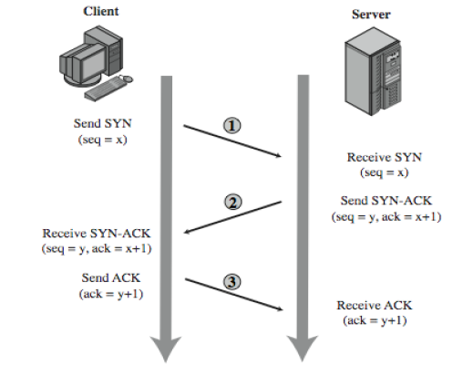
TCP 3-way connection handshake
Address,
Port number,
Seq x
Recorded in a table of known TCP connections
Server in LISTEN State
Vulnerability: Unbounded ness of LISTEN state

Slide 15
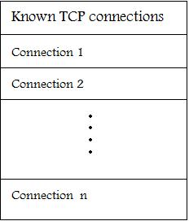
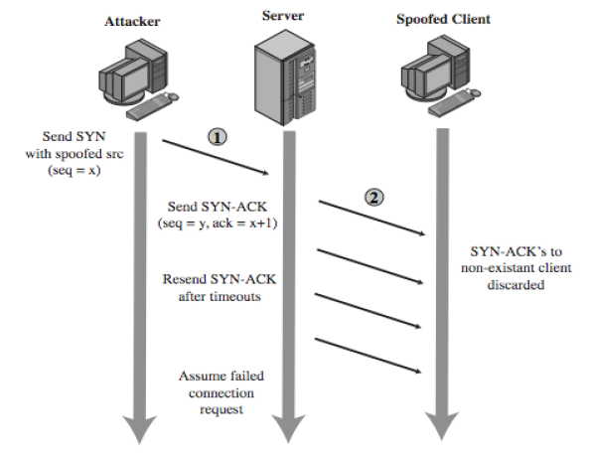
SYN spoofing cont’d ….

Slide 16
Factors considered by attacker for SYN spoofing
The number of sent forged packets are just large enough to exhaust the table but small as compared to a typical flooding attack
Keep sufficient volume of forged requests flowing
  Keep the table constantly full with no timed-out requests
Make sure to use addresses that will not respond to the SYN-ACK with a RST
  Overloading the spoofed client
  Using a wide range of random addresses
  A collection of compromised hosts under the attacker's control (i.e., a "botnet") could be used

Slide 17
Detecting SYN spoof attack
After the target system has tried to send a SYN/ACK packet to the client and while it is waiting to receive an ACK packet, the existing connection is said to be half open or host in SYN_RECEIVED state
If your system is in this state, it may be experiencing SYN-spoof attack
To determine whether connections on your system are half open, type netstat –a command
This command gives a set of active connections .Check for those in the state SYN_RECEIVED which is an indication of the threat of SYN spoof attack
Source: Fadia (2007)

Slide 18
Firewall as Semi-transparent Gateway
SYN
SYN+ACK
ACK
Timeout
RST
S
D
Firewall

Slide 19
System Configuration Improvements
1) Decrease timeout period
  Reset the connections sooner
  Can deny legitimate access where the timeout period will be less than the round trip times
2) Increase the number of half-open connections
  More connections at the same time
  Will increase the use of resources

Slide 20
SYN Cache
Global hash table instead of the usual per socket queued connections
Protection from running out of the resources
Limit on number of entries in the table and hash bucket
Limit on the memory usage and amount of time taken to search for a matching entry

Slide 21
SYN Cache (cont’d)
Queue is divided into hash buckets
Each bucket treated as a First in First out Queue.
Hash value computed by choosing a function of source and destination IP addresses, ports and a secret key
Hash value acts as an index in the hash table.
Secret key transforms hash value so that an attacker cannot target specific hash bucket and deny service to a specific machine

Slide 22
Conclusion
SYN Flooding denial of service attack one of the most common attacks
Caused by the flaws in TCP protocol
Not possible to eliminate the attack
Possible to reduce the danger by taking the described measures properly

Slide 23
Thank you

